Slide 1
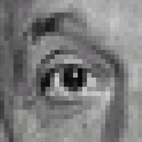

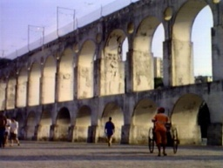
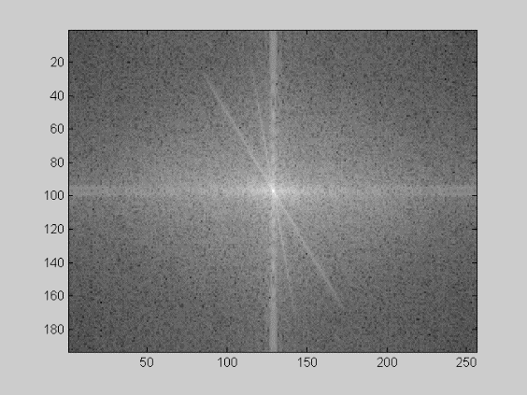
Recap of Filtering
Linear filtering is dot product at each position
Not a matrix multiplication
Can smooth, sharpen, translate (among many other uses)
We can use the Fourier transform to represent images in the frequency domain.
Filtering in the spatial domain is multiplication in the frequency domain.
1
1
1
1
1
1
1
1
1

Slide 2
This lecture
Image Formation
Biological Vision
Light and Color

Slide 3
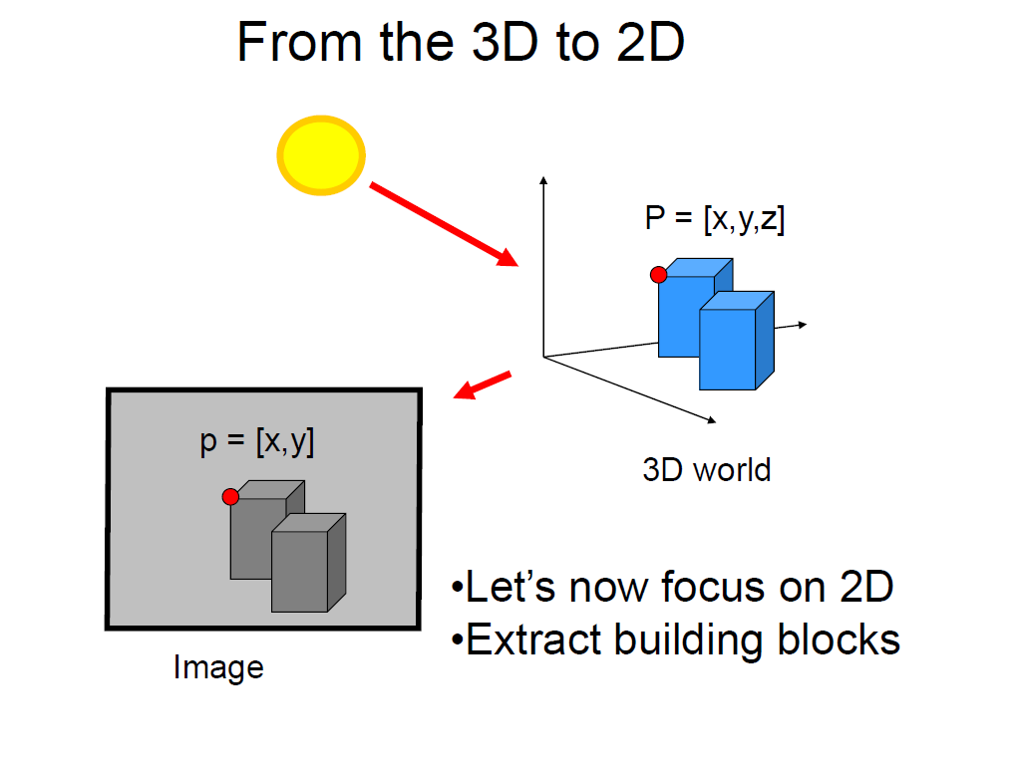
Slide credit Fei Fei Li

Slide 4


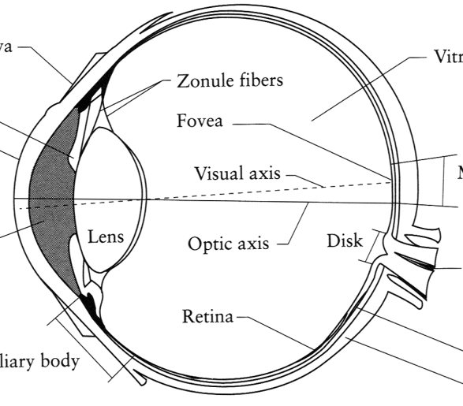
Image Formation
Digital Camera
Film
The Eye

Slide 5
A photon’s life choices
Absorption
Diffusion
Reflection
Transparency
Refraction
Fluorescence
Subsurface scattering
Phosphorescence
Interreflection
light source
λ
?

Slide 6
A photon’s life choices
Absorption
Diffusion
Reflection
Transparency
Refraction
Fluorescence
Subsurface scattering
Phosphorescence
Interreflection
light source
λ

Slide 7
A photon’s life choices
Absorption
Diffuse Reflection
Reflection
Transparency
Refraction
Fluorescence
Subsurface scattering
Phosphorescence
Interreflection
light source
λ

Slide 8
A photon’s life choices
Absorption
Diffusion
Specular Reflection
Transparency
Refraction
Fluorescence
Subsurface scattering
Phosphorescence
Interreflection
light source
λ

Slide 9
A photon’s life choices
Absorption
Diffusion
Reflection
Transparency
Refraction
Fluorescence
Subsurface scattering
Phosphorescence
Interreflection
light source
λ

Slide 10
A photon’s life choices
Absorption
Diffusion
Reflection
Transparency
Refraction
Fluorescence
Subsurface scattering
Phosphorescence
Interreflection
light source
λ

Slide 11
A photon’s life choices
Absorption
Diffusion
Reflection
Transparency
Refraction
Fluorescence
Subsurface scattering
Phosphorescence
Interreflection
light source
λ₁
λ₂

Slide 12
A photon’s life choices
Absorption
Diffusion
Reflection
Transparency
Refraction
Fluorescence
Subsurface scattering
Phosphorescence
Interreflection
light source
λ

Slide 13
A photon’s life choices
Absorption
Diffusion
Reflection
Transparency
Refraction
Fluorescence
Subsurface scattering
Phosphorescence
Interreflection
light source
t=1
t=n

Slide 14
A photon’s life choices
Absorption
Diffusion
Reflection
Transparency
Refraction
Fluorescence
Subsurface scattering
Phosphorescence
Interreflection
light source
λ
(Specular Interreflection)

Slide 15
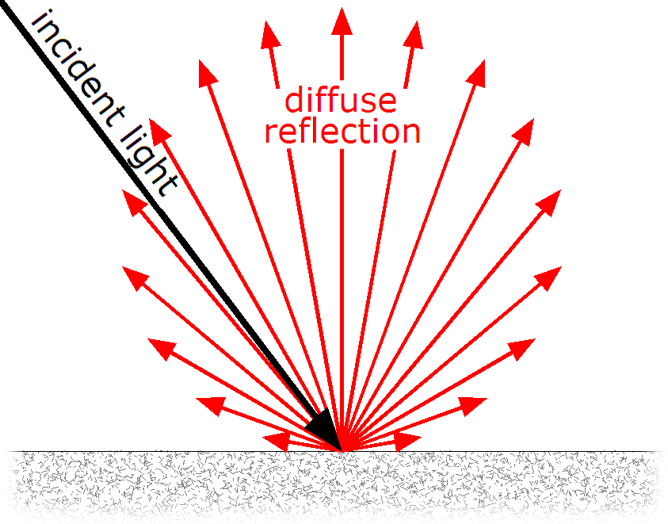
Lambertian Reflectance
In computer vision, the complexity of light transport is mostly ignored.
Surfaces are often assumed to be ideal diffuse reflectors with no dependence on viewing direction.
https://en.wikipedia.org/wiki/Lambertian_reflectance

Slide 16
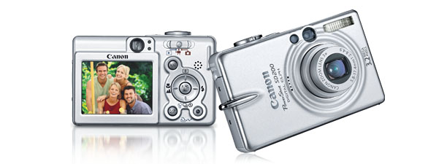
Digital camera
A digital camera replaces film with a sensor array
Each cell in the array is light-sensitive diode that converts photons to electrons
Two common types
Charge Coupled Device (CCD)
CMOS
http://electronics.howstuffworks.com/digital-camera.htm
Slide by Steve Seitz

Slide 17
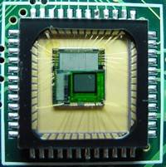
Sensor Array
CMOS sensor

Slide 18
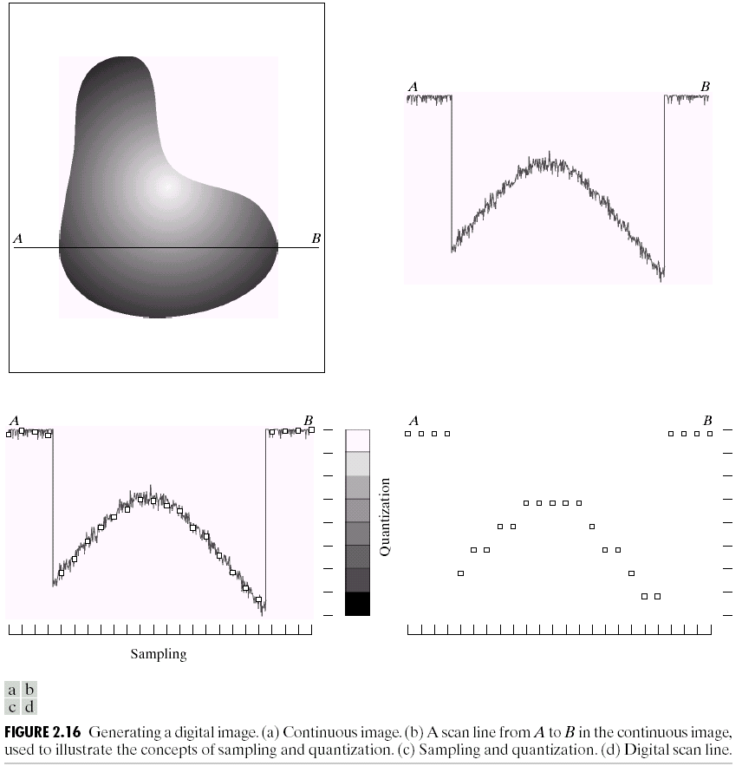
Sampling and Quantization

Slide 19
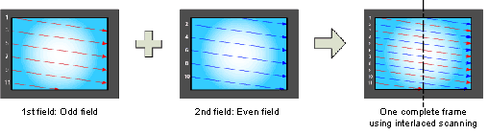
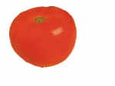
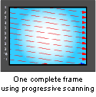
Interlace vs. progressive scan
http://www.axis.com/products/video/camera/progressive_scan.htm
Slide by Steve Seitz

Slide 20
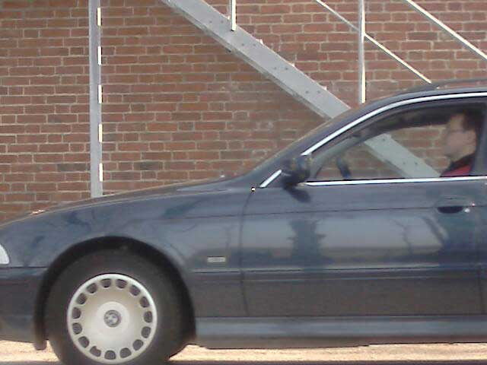
Progressive scan or Global shutter
http://www.axis.com/products/video/camera/progressive_scan.htm
Slide by Steve Seitz

Slide 21
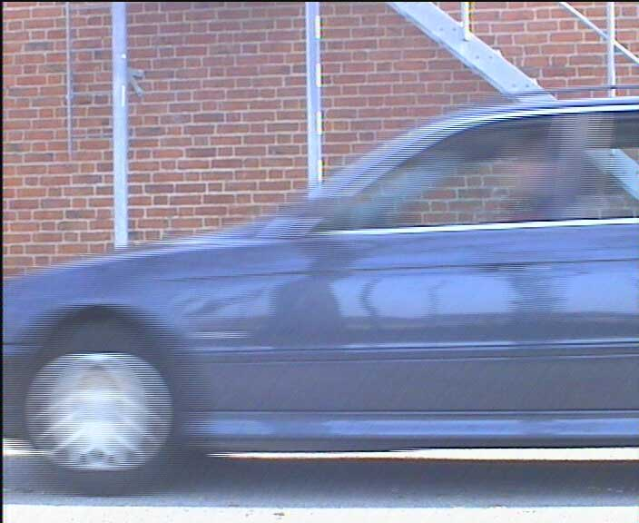
Interlaced
http://www.axis.com/products/video/camera/progressive_scan.htm
Slide by Steve Seitz

Slide 22
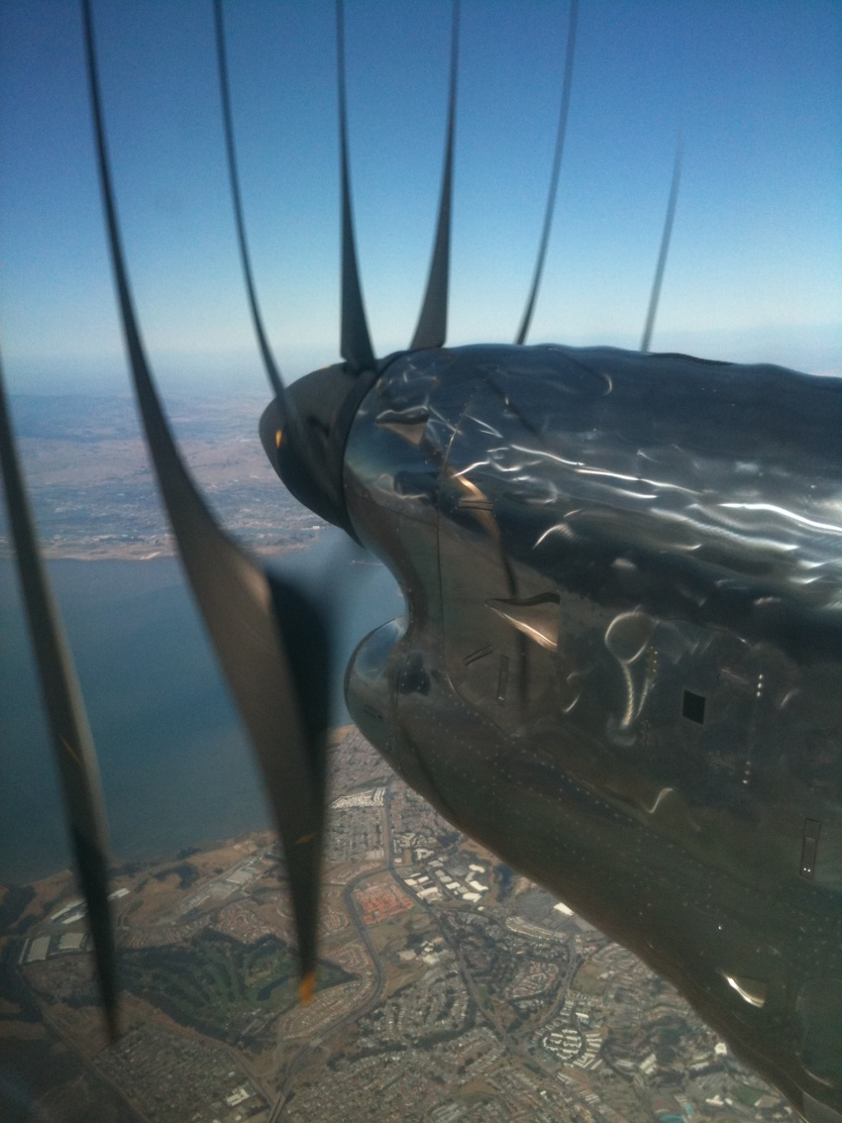
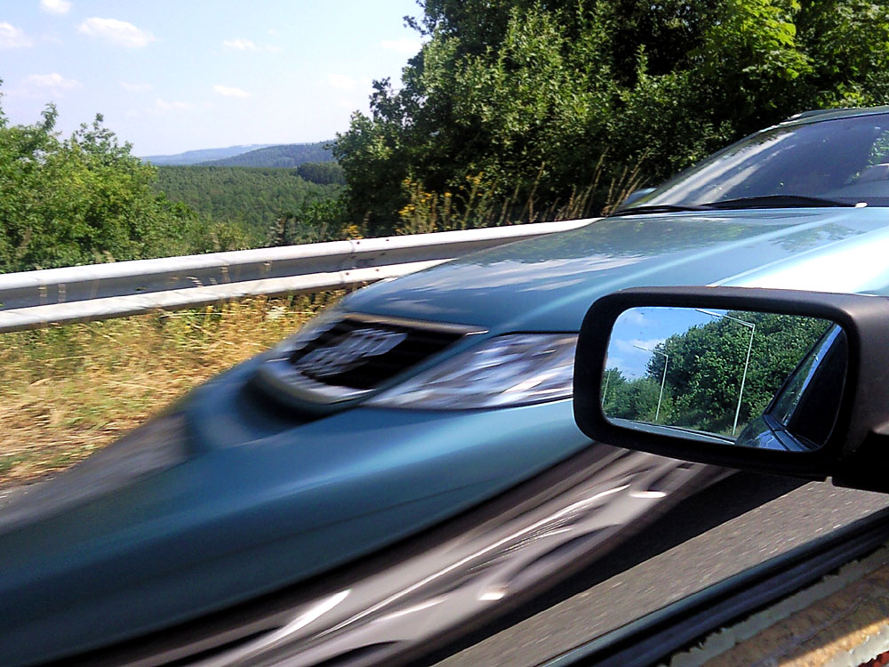
Rolling Shutter
Notes:
http://en.wikipedia.org/wiki/Rolling_shutter
Even DSLRs have this problem.

Slide 23

The Eye
The human eye is a camera!
Iris - colored annulus with radial muscles
Pupil - the hole (aperture) whose size is controlled by the iris
What’s the “film”?
photoreceptor cells (rods and cones) in the retina
Slide by Steve Seitz

Slide 24
Aside: why do we care about human vision in this class?
We don’t, necessarily.

Slide 25
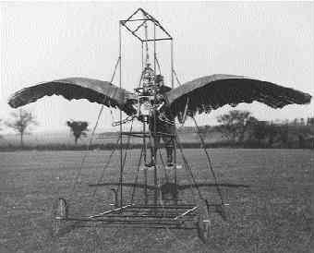
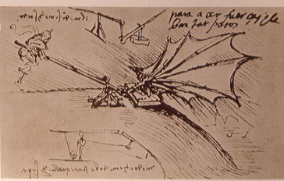
Ornithopters

Slide 26
Why do we care about human vision?
We don’t, necessarily.
But cameras necessarily imitate the frequency response of the human eye, so we should know that much.
Also, computer vision probably wouldn’t get as much scrutiny if biological vision (especially human vision) hadn’t proved that it was possible to make important judgements from 2d images.

Slide 27
Does computer vision “understand” images?
"Can machines fly?" The answer is yes, because airplanes fly.
"Can machines swim?" The answer is no, because submarines don't swim.
"Can machines think?" Is this question like the first, or like the second?
Source: Norvig

Slide 28
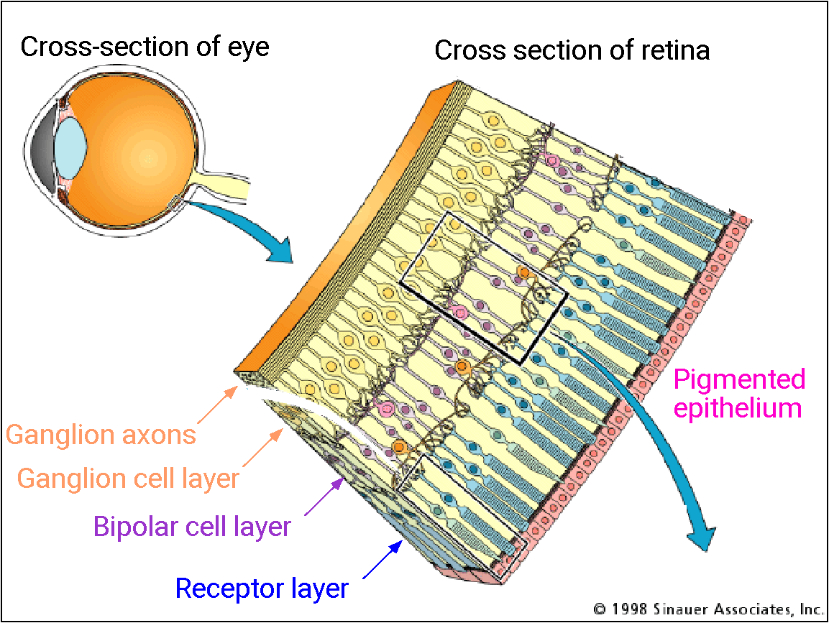
The Retina

Slide 29
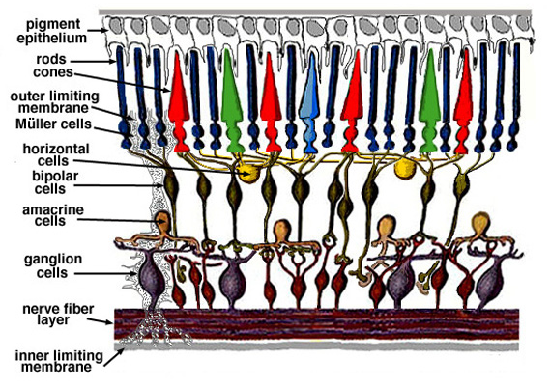
Retina up-close
Light
Notes:
Tapetum lucidum

Slide 30
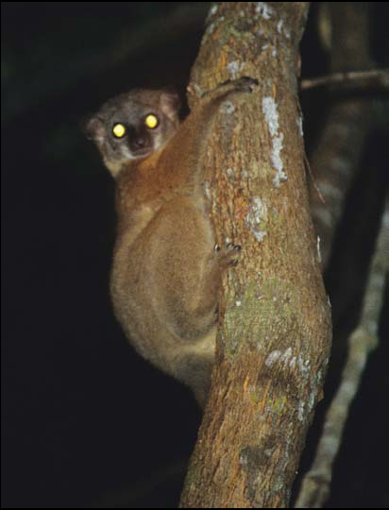
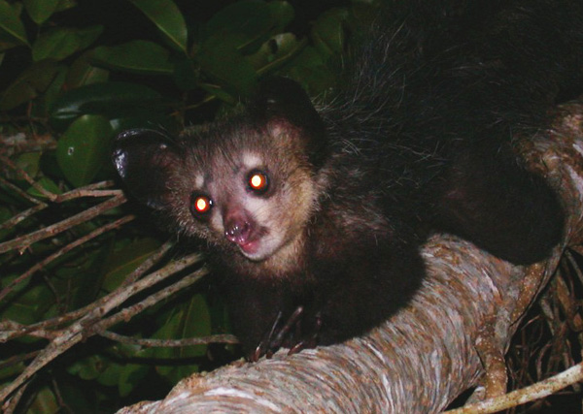
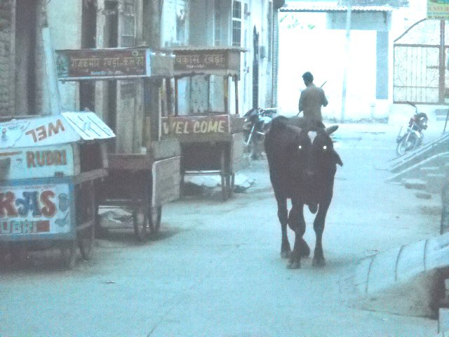
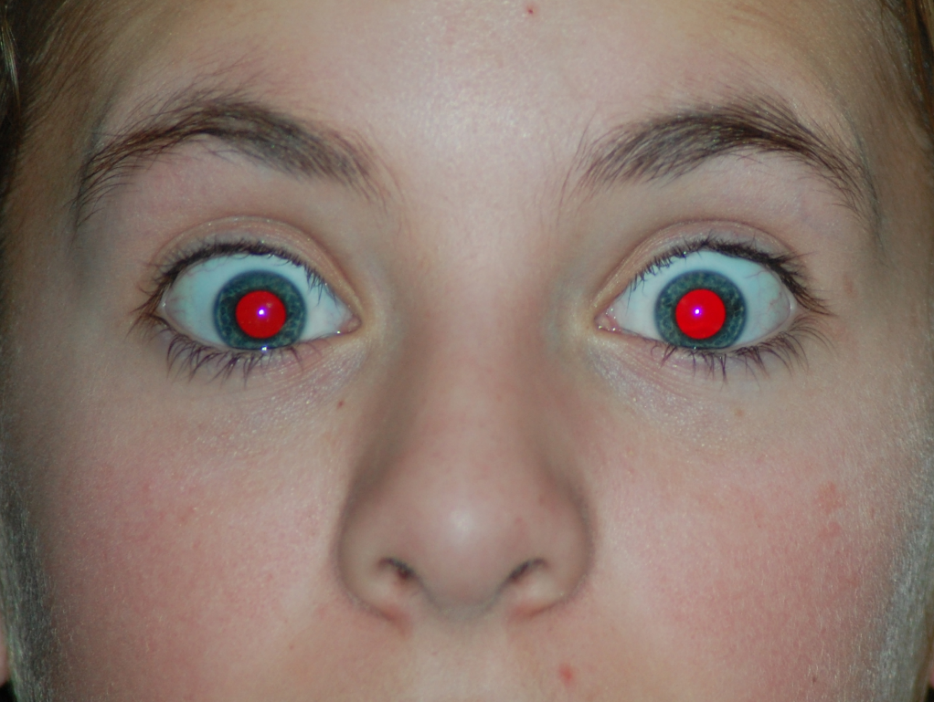
What humans don’t have: tapetum lucidum
Human eyes can reflect a tiny bit and blood in the retina makes this reflection red.
Notes:
Animals with Tapetum Lucidum also have RPE, just not in the same part of the eye.

Slide 31
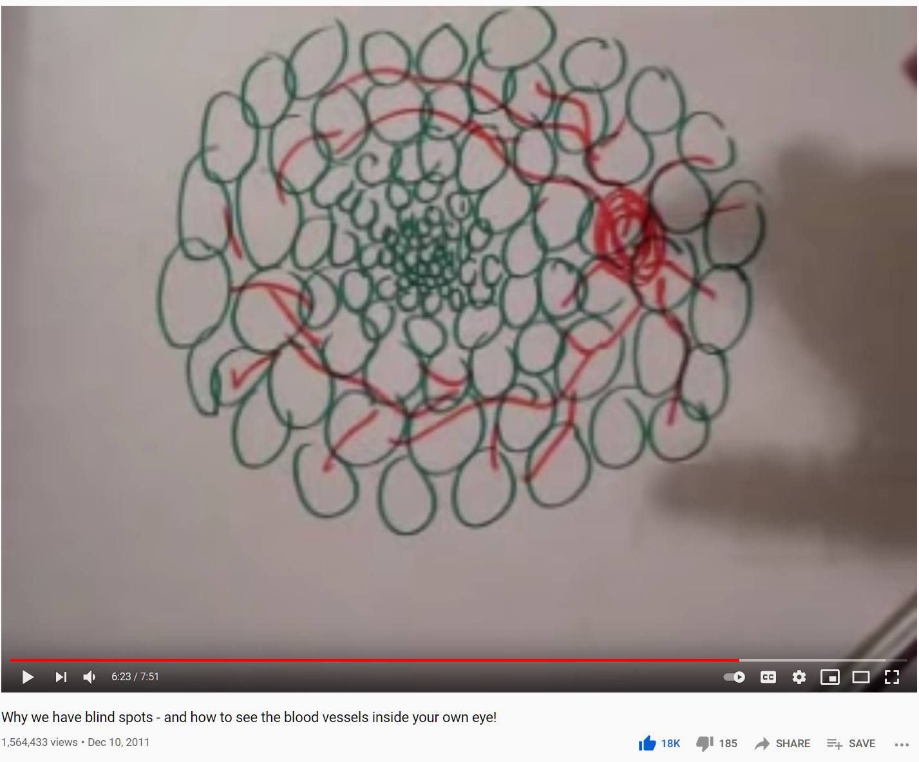
Wait, the blood vessels are in front of the photoreceptors??
https://www.youtube.com/watch?v=L_W-IXqoxHA
Notes:
Yes, and you can see them!

Slide 33
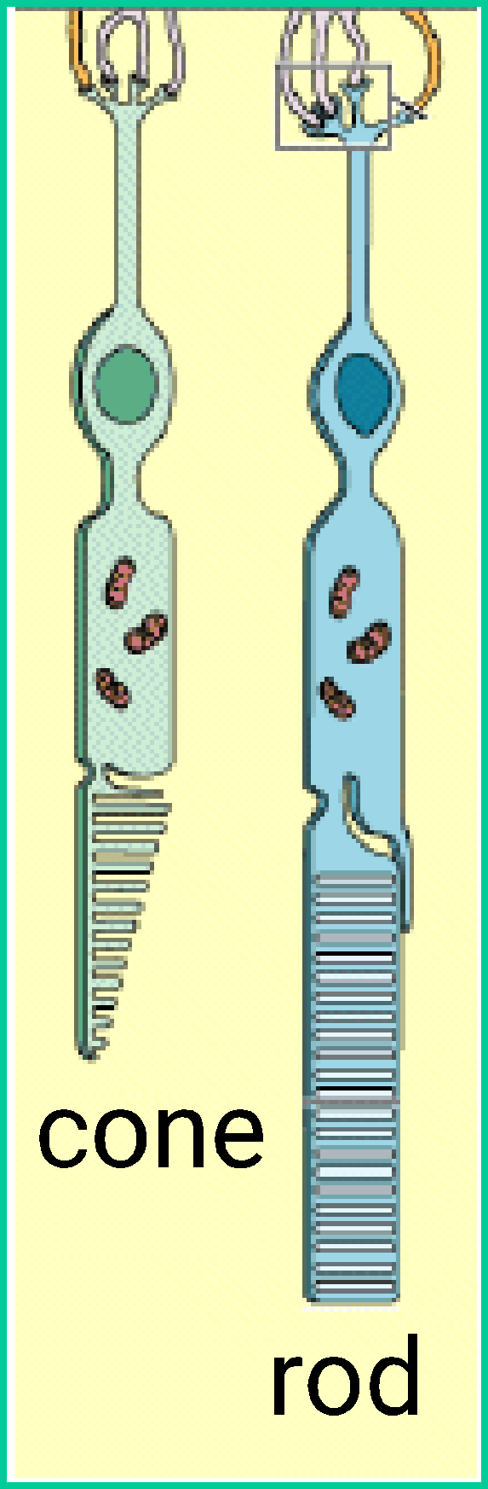
Two types of light-sensitive receptors
Cones
cone-shaped
less sensitive
operate in high light
color vision
Rods
rod-shaped
highly sensitive
operate at night
gray-scale vision
© Stephen E. Palmer, 2002

Slide 34
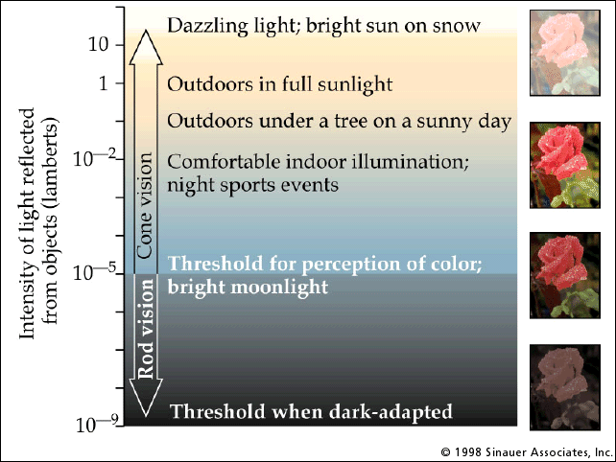
Rod / Cone sensitivity

Slide 35
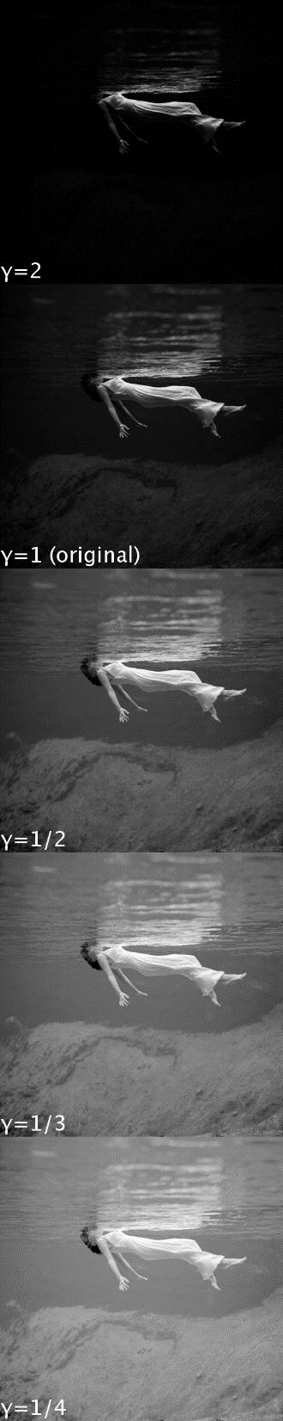
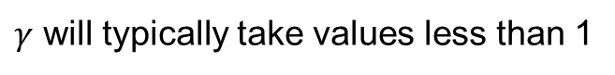
Camera Gamma Curve
In this class (e.g. for project 1), you are manipulating encoded brightness values. A pixel with value of “100” is not necessarily twice as bright as a pixel with value “50”.
https://en.wikipedia.org/wiki/Gamma_correction

Slide 36
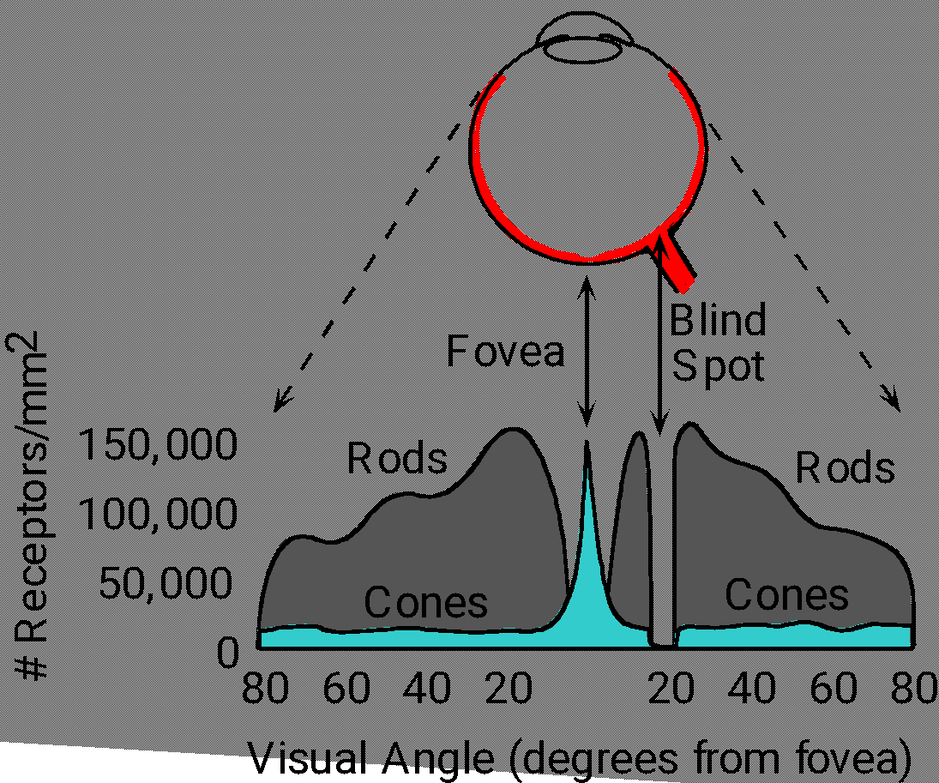
Distribution of Rods and Cones
Night Sky: why are there more stars off-center? Averted vision: http://en.wikipedia.org/wiki/Averted_vision
© Stephen E. Palmer, 2002

Slide 37
Eye Movements
Saccades
Can be consciously controlled. Related to perceptual attention.
200ms to initiation, 20 to 200ms to carry out. Large amplitude.
Microsaccades
Involuntary. Smaller amplitude. Especially evident during prolonged fixation. Function debated.
Ocular microtremor (OMT)
Involuntary. high frequency (up to 80Hz), small amplitude.
Smooth pursuit – tracking an object

Slide 38
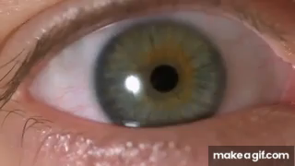
Slow mo guys – Saccades and CRTs
https://youtu.be/Fmg9ZOHESgQ?t=21s
https://youtu.be/3BJU2drrtCM

Slide 39
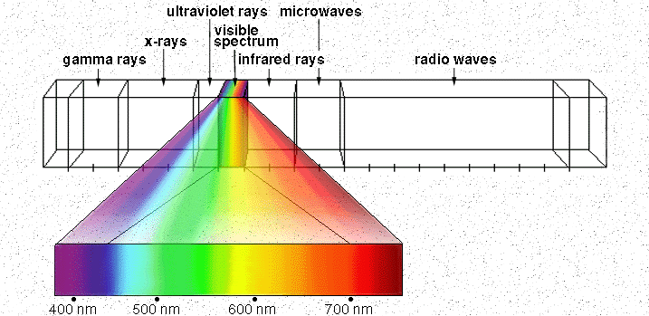
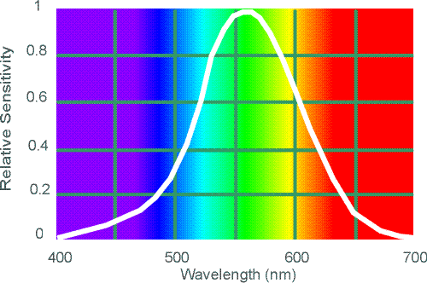
Electromagnetic Spectrum
Human Luminance Sensitivity Function
http://www.yorku.ca/eye/photopik.htm
Notes:
At least 3 spectral bands required (e.g. R,G,B)

Slide 40
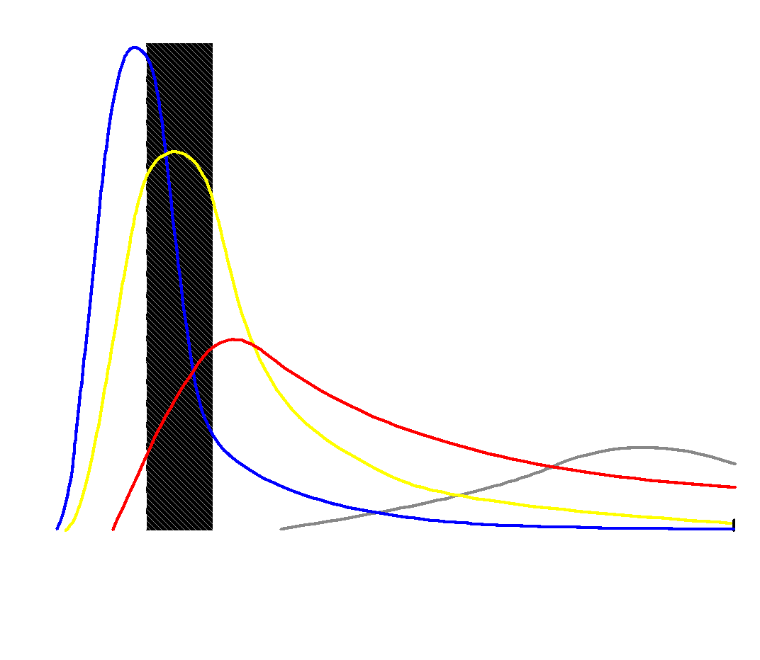
Visible Light
Why do we see light of these wavelengths?
…because that’s where the
Sun radiates EM energy
© Stephen E. Palmer, 2002
Notes:
Because that’s where the Sun’s peak radiation was
Because the atmosphere is fairly transparent in that range
Because biology has many important markers in that range (but that’s because of the previous two reasons)

Slide 41


The Physics of Light
Any patch of light can be completely described
physically by its spectrum: the number of photons
(per time unit) at each wavelength 400 - 700 nm.
© Stephen E. Palmer, 2002

Slide 42
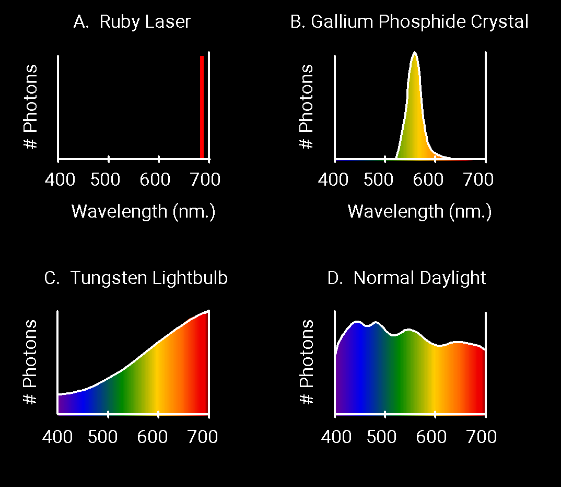
The Physics of Light
Some examples of the spectra of light sources
© Stephen E. Palmer, 2002

Slide 43
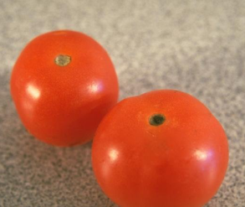
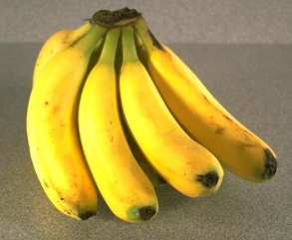
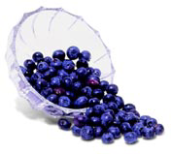
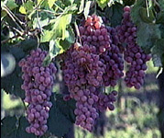
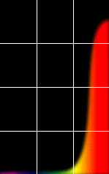
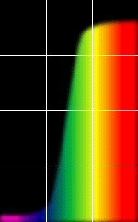
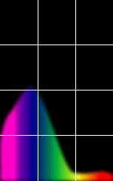
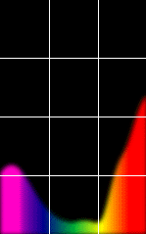
The Physics of Light
Some examples of the reflectance spectra of surfaces
Red
Yellow
Blue
Purple
% Photons Reflected
400 700
400 700
400 700
400 700
Wavelength (nm)
© Stephen E. Palmer, 2002

Slide 44

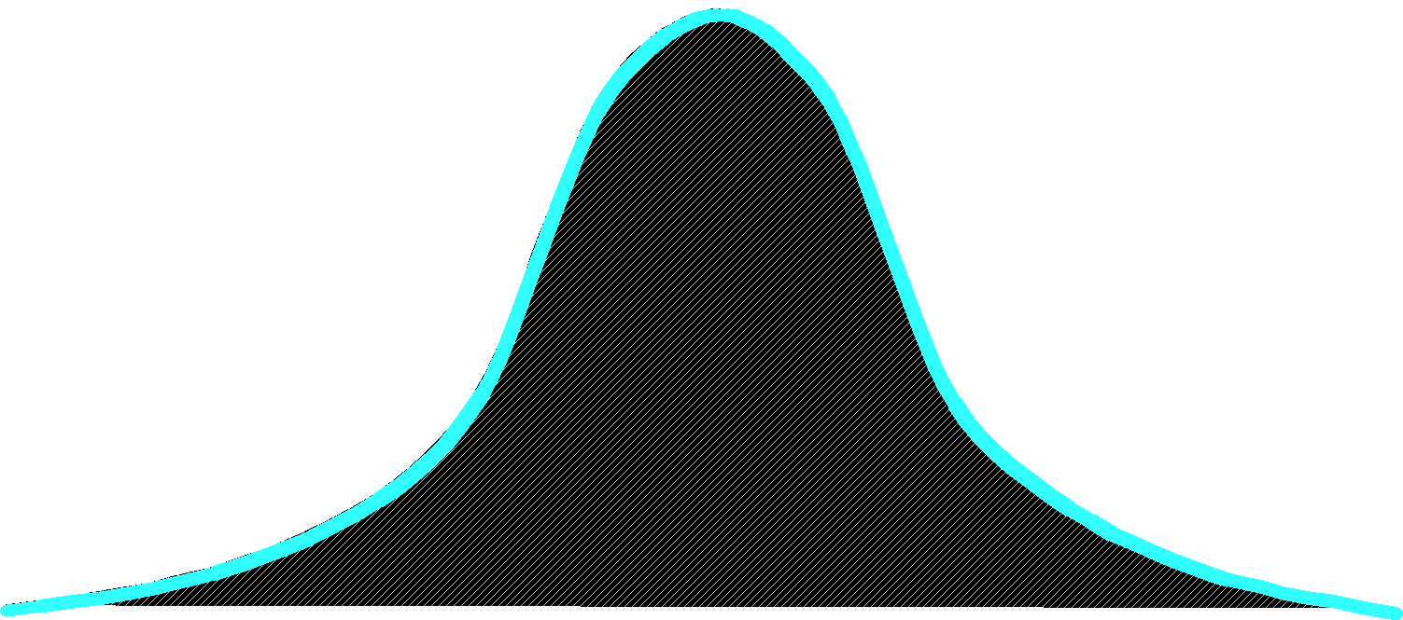
The Psychophysical Correspondence
There is no simple functional description for the perceived
color of all lights under all viewing conditions, but …...
A helpful constraint:
Consider only physical spectra with normal distributions
mean
area
variance
© Stephen E. Palmer, 2002

Slide 45
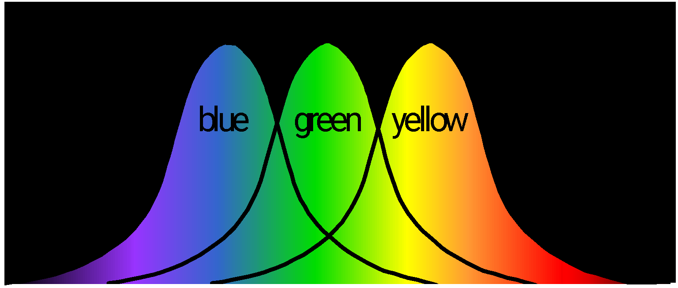
The Psychophysical Correspondence
Mean
Hue
# Photons
Wavelength
© Stephen E. Palmer, 2002

Slide 46

The Psychophysical Correspondence
Variance
Saturation
# Photons
Wavelength
© Stephen E. Palmer, 2002

Slide 47
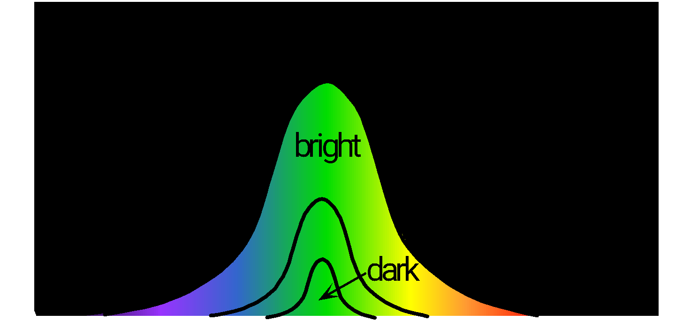
The Psychophysical Correspondence
Area
Brightness
# Photons
Wavelength
© Stephen E. Palmer, 2002

Slide 48

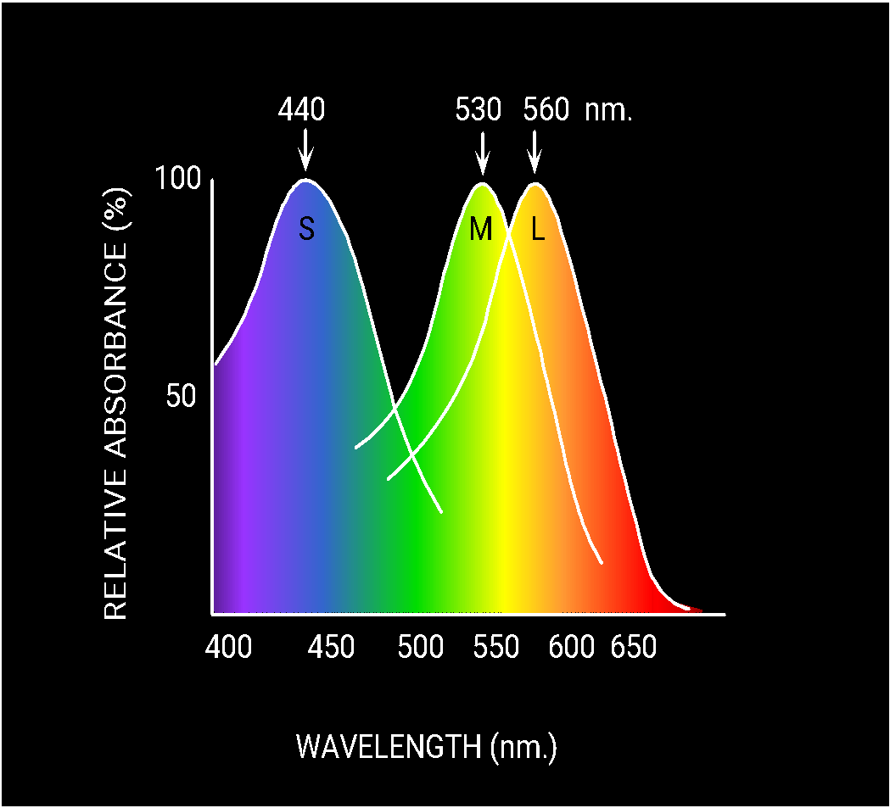
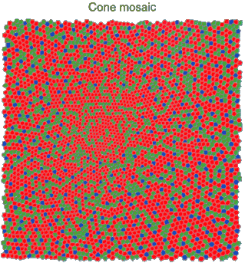
Physiology of Color Vision
Three kinds of cones:
Why are M and L cones so close?
Why are there 3?
© Stephen E. Palmer, 2002

Slide 49


Impossible Colors
Can you make the cones respond in ways that typical light spectra never would?
http://en.wikipedia.org/wiki/Impossible_colors

Slide 50
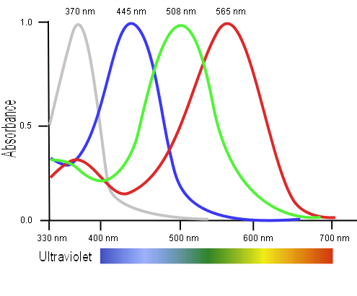
Tetrachromacy
Bird cone responses
Most birds, and many other animals, have cones for ultraviolet light.
Some humans, mostly female, seem to have slight tetrachromatism.

Slide 51
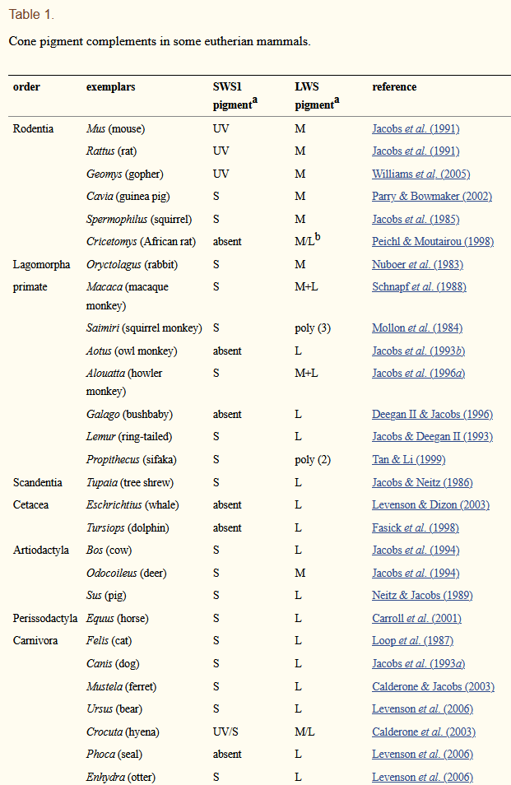

Jacobs GH. Evolution of colour vision in mammals. Philos Trans R Soc Lond B Biol Sci. 2009;364(1531):2957-2967. doi:10.1098/rstb.2009.0039

Slide 52

More Spectra
metamers
Notes:
Metamerism can be illuminant based or observer based. Color blindness produced well known instances of metamerism.

Slide 53

Color can be ambiguous

Slide 54
Color can be ambiguous

Slide 55

https://en.wikipedia.org/wiki/The_dress

Slide 56

https://en.wikipedia.org/wiki/The_dress
Notes:
https://en.wikipedia.org/wiki/The_dress

Slide 57


Color Sensing in Camera (RGB)
3-chip vs. 1-chip: quality vs. cost
Why more green?
Why 3 colors?
http://www.cooldictionary.com/words/Bayer-filter.wikipedia
Slide by Steve Seitz

Slide 58


Practical Color Sensing: Bayer Grid
Estimate RGB at ‘G’ cells from neighboring values
Slide by Steve Seitz

Slide 59




Color Image
R
G
B

Slide 60
Images in Python
Images represented as a matrix
Suppose we have a NxM RGB image called “im”
im(0,0,0) = top-left pixel value in R-channel
im(y, x, b) = y pixels down, x pixels to right in the b^{th} channel
im(N-1, M-1, 2) = bottom-right pixel in B-channel
column
row
R
0.92 | 0.93 | 0.94 | 0.97 | 0.62 | 0.37 | 0.85 | 0.97 | 0.93 | 0.92 | 0.99
0.95 | 0.89 | 0.82 | 0.89 | 0.56 | 0.31 | 0.75 | 0.92 | 0.81 | 0.95 | 0.91
0.89 | 0.72 | 0.51 | 0.55 | 0.51 | 0.42 | 0.57 | 0.41 | 0.49 | 0.91 | 0.92
0.96 | 0.95 | 0.88 | 0.94 | 0.56 | 0.46 | 0.91 | 0.87 | 0.90 | 0.97 | 0.95
0.71 | 0.81 | 0.81 | 0.87 | 0.57 | 0.37 | 0.80 | 0.88 | 0.89 | 0.79 | 0.85
0.49 | 0.62 | 0.60 | 0.58 | 0.50 | 0.60 | 0.58 | 0.50 | 0.61 | 0.45 | 0.33
0.86 | 0.84 | 0.74 | 0.58 | 0.51 | 0.39 | 0.73 | 0.92 | 0.91 | 0.49 | 0.74
0.96 | 0.67 | 0.54 | 0.85 | 0.48 | 0.37 | 0.88 | 0.90 | 0.94 | 0.82 | 0.93
0.69 | 0.49 | 0.56 | 0.66 | 0.43 | 0.42 | 0.77 | 0.73 | 0.71 | 0.90 | 0.99
0.79 | 0.73 | 0.90 | 0.67 | 0.33 | 0.61 | 0.69 | 0.79 | 0.73 | 0.93 | 0.97
0.91 | 0.94 | 0.89 | 0.49 | 0.41 | 0.78 | 0.78 | 0.77 | 0.89 | 0.99 | 0.93
G
0.92 | 0.93 | 0.94 | 0.97 | 0.62 | 0.37 | 0.85 | 0.97 | 0.93 | 0.92 | 0.99
0.95 | 0.89 | 0.82 | 0.89 | 0.56 | 0.31 | 0.75 | 0.92 | 0.81 | 0.95 | 0.91
0.89 | 0.72 | 0.51 | 0.55 | 0.51 | 0.42 | 0.57 | 0.41 | 0.49 | 0.91 | 0.92
0.96 | 0.95 | 0.88 | 0.94 | 0.56 | 0.46 | 0.91 | 0.87 | 0.90 | 0.97 | 0.95
0.71 | 0.81 | 0.81 | 0.87 | 0.57 | 0.37 | 0.80 | 0.88 | 0.89 | 0.79 | 0.85
0.49 | 0.62 | 0.60 | 0.58 | 0.50 | 0.60 | 0.58 | 0.50 | 0.61 | 0.45 | 0.33
0.86 | 0.84 | 0.74 | 0.58 | 0.51 | 0.39 | 0.73 | 0.92 | 0.91 | 0.49 | 0.74
0.96 | 0.67 | 0.54 | 0.85 | 0.48 | 0.37 | 0.88 | 0.90 | 0.94 | 0.82 | 0.93
0.69 | 0.49 | 0.56 | 0.66 | 0.43 | 0.42 | 0.77 | 0.73 | 0.71 | 0.90 | 0.99
0.79 | 0.73 | 0.90 | 0.67 | 0.33 | 0.61 | 0.69 | 0.79 | 0.73 | 0.93 | 0.97
0.91 | 0.94 | 0.89 | 0.49 | 0.41 | 0.78 | 0.78 | 0.77 | 0.89 | 0.99 | 0.93
B
0.92 | 0.93 | 0.94 | 0.97 | 0.62 | 0.37 | 0.85 | 0.97 | 0.93 | 0.92 | 0.99
0.95 | 0.89 | 0.82 | 0.89 | 0.56 | 0.31 | 0.75 | 0.92 | 0.81 | 0.95 | 0.91
0.89 | 0.72 | 0.51 | 0.55 | 0.51 | 0.42 | 0.57 | 0.41 | 0.49 | 0.91 | 0.92
0.96 | 0.95 | 0.88 | 0.94 | 0.56 | 0.46 | 0.91 | 0.87 | 0.90 | 0.97 | 0.95
0.71 | 0.81 | 0.81 | 0.87 | 0.57 | 0.37 | 0.80 | 0.88 | 0.89 | 0.79 | 0.85
0.49 | 0.62 | 0.60 | 0.58 | 0.50 | 0.60 | 0.58 | 0.50 | 0.61 | 0.45 | 0.33
0.86 | 0.84 | 0.74 | 0.58 | 0.51 | 0.39 | 0.73 | 0.92 | 0.91 | 0.49 | 0.74
0.96 | 0.67 | 0.54 | 0.85 | 0.48 | 0.37 | 0.88 | 0.90 | 0.94 | 0.82 | 0.93
0.69 | 0.49 | 0.56 | 0.66 | 0.43 | 0.42 | 0.77 | 0.73 | 0.71 | 0.90 | 0.99
0.79 | 0.73 | 0.90 | 0.67 | 0.33 | 0.61 | 0.69 | 0.79 | 0.73 | 0.93 | 0.97
0.91 | 0.94 | 0.89 | 0.49 | 0.41 | 0.78 | 0.78 | 0.77 | 0.89 | 0.99 | 0.93

Slide 61

Color spaces
How can we represent color?
http://en.wikipedia.org/wiki/File:RGB_illumination.jpg

Slide 62





Color spaces: RGB
Default color space
0,1,0
R
(G=0,B=0)
1,0,0
G
(R=0,B=0)
0,0,1
B
(R=0,G=0)
Some drawbacks
Strongly correlated channels
Non-perceptual
Image from: http://en.wikipedia.org/wiki/File:RGB_color_solid_cube.png

Slide 63




Color spaces: HSV
Intuitive color space
H
(S=1,V=1)
S
(H=1,V=1)
V
(H=1,S=0)

Slide 64






Color spaces: YCbCr
Fast to compute, good for compression, used by TV
Y=0
Y=0.5
Y
(Cb=0.5,Cr=0.5)
Cr
Cb
(Y=0.5,Cr=0.5)
Cb
Y=1
Cr
(Y=0.5,Cb=05)

Slide 65




Color spaces: L*a*b*
“Perceptually uniform”* color space
L
(a=0,b=0)
a
(L=65,b=0)
b
(L=65,a=0)

Slide 66
If you had to choose, would you rather go without luminance or chrominance?

Slide 67
If you had to choose, would you rather go without luminance or chrominance?

Slide 68

Most information in intensity
Only color shown – constant intensity

Slide 69

Most information in intensity
Only intensity shown – constant color

Slide 70
Most information in intensity
Original image

Slide 71

Back to grayscale intensity
0.92 | 0.93 | 0.94 | 0.97 | 0.62 | 0.37 | 0.85 | 0.97 | 0.93 | 0.92 | 0.99
0.95 | 0.89 | 0.82 | 0.89 | 0.56 | 0.31 | 0.75 | 0.92 | 0.81 | 0.95 | 0.91
0.89 | 0.72 | 0.51 | 0.55 | 0.51 | 0.42 | 0.57 | 0.41 | 0.49 | 0.91 | 0.92
0.96 | 0.95 | 0.88 | 0.94 | 0.56 | 0.46 | 0.91 | 0.87 | 0.90 | 0.97 | 0.95
0.71 | 0.81 | 0.81 | 0.87 | 0.57 | 0.37 | 0.80 | 0.88 | 0.89 | 0.79 | 0.85
0.49 | 0.62 | 0.60 | 0.58 | 0.50 | 0.60 | 0.58 | 0.50 | 0.61 | 0.45 | 0.33
0.86 | 0.84 | 0.74 | 0.58 | 0.51 | 0.39 | 0.73 | 0.92 | 0.91 | 0.49 | 0.74
0.96 | 0.67 | 0.54 | 0.85 | 0.48 | 0.37 | 0.88 | 0.90 | 0.94 | 0.82 | 0.93
0.69 | 0.49 | 0.56 | 0.66 | 0.43 | 0.42 | 0.77 | 0.73 | 0.71 | 0.90 | 0.99
0.79 | 0.73 | 0.90 | 0.67 | 0.33 | 0.61 | 0.69 | 0.79 | 0.73 | 0.93 | 0.97
0.91 | 0.94 | 0.89 | 0.49 | 0.41 | 0.78 | 0.78 | 0.77 | 0.89 | 0.99 | 0.93

Slide 72
Wrap up: Why do we care about cameras and eyes?
Notes:
December 6th, 2021 New York Times

Slide 73

Notes:
December 6th, 2021 New York Times

Slide 74


Slide 75


Slide 76

Another driving system with human level eyesight

Slide 77

https://twitter.com/JordanTeslaTech/status/1418413307862585344

Slide 78

https://www.reddit.com/r/teslamotors/comments/nrs8kf/you_think_ice_cream_truck_stop_signs_are_a_problem/

Slide 79
On the whole, cameras are a reasonable analogy for eyes. They do capture sufficient information for safe driving 99.9% of the time.

Slide 80

https://www.youtube.com/watch?v=s1eTBMYEs-Y
Notes:
But maybe some cameras don’t have enough dynamic range at the moment

Slide 81
On the whole, cameras are a reasonable analogy for eyes. They do capture sufficient information for safe driving 99.9% of the time.
Imagine remote controlling a vehicle based on a camera feed.
But the computer vision and machine learning methods that interpret the camera images are not yet a reasonable analogy for the human brain.

Slide 82
Next: Interest points and corners
Slides: Hoiem, Efros, and others

